Slide 1
Home page
Click ‘rankings’ to see options.
Find the best times for any swimmer

Slide 2
Enter the swimmer’s Swim England number or surname.

Slide 3
Click the Swim England number to see the swimmer’s times.

Slide 4
Click the event to see all times posted by this swimmer

Slide 5
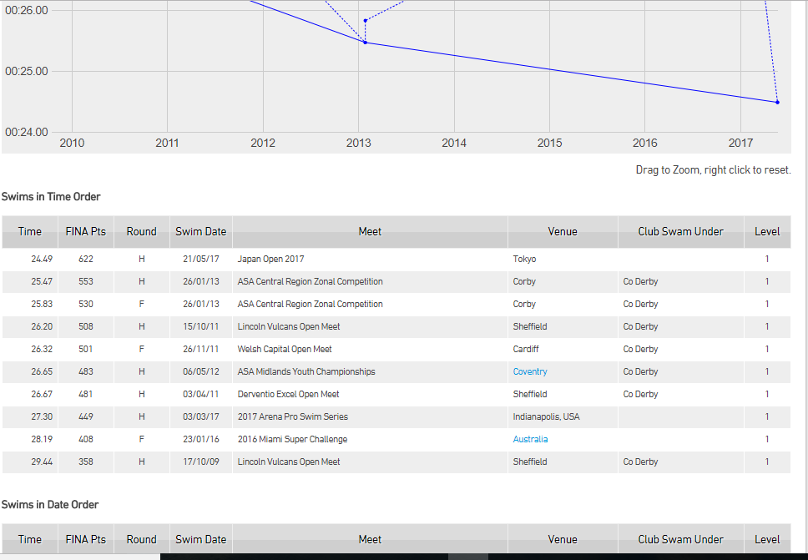

Slide 6
Find the top ranked swimmers in an event

Slide 7
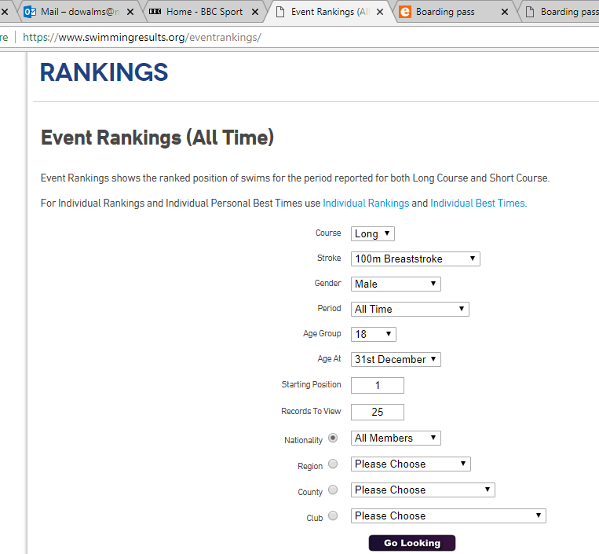
All time or a particular year
Choose how many swimmers you want to see
Choose the fastest swimmers in the country, region, county or club.

Slide 8
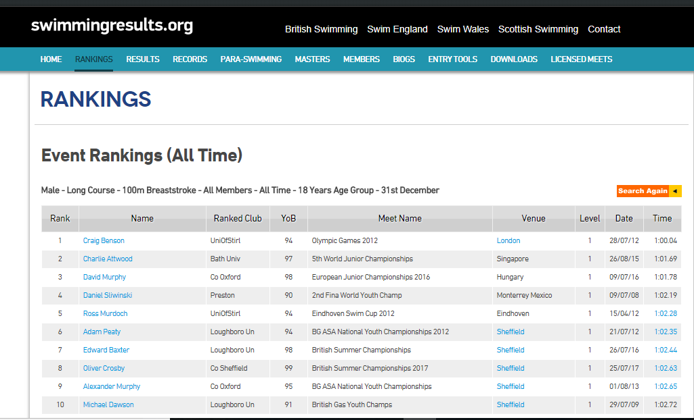

Slide 9
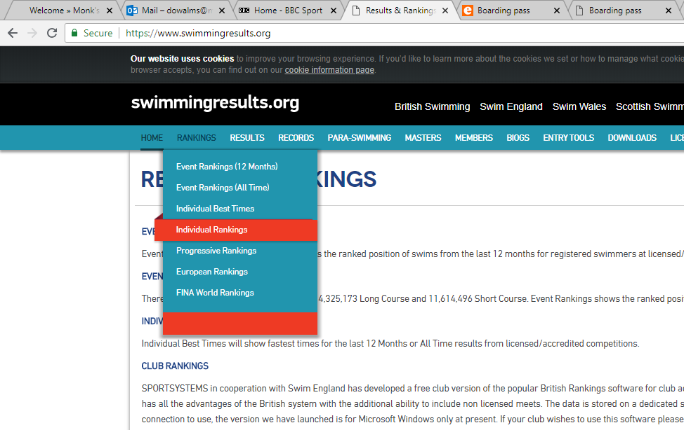
Find where a swimmer’s time ranks her against other swimmers.

Slide 10
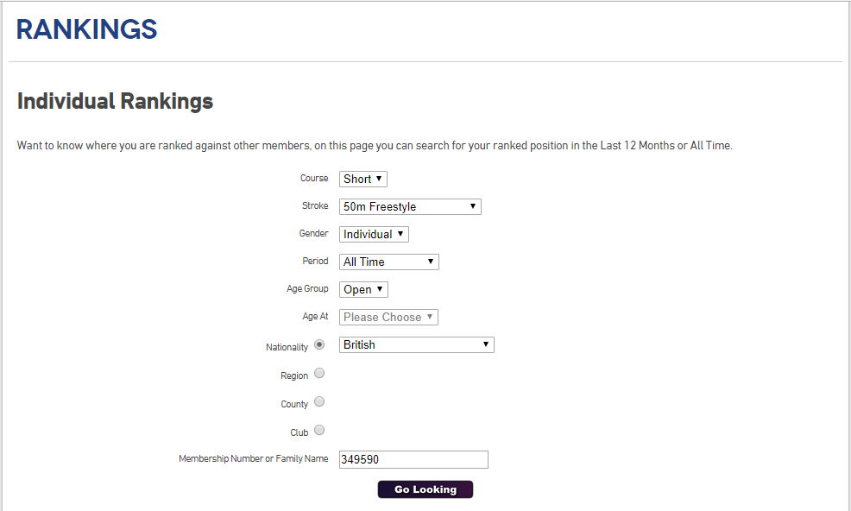
All time or a particular year
Find a swimmer’s ranking in the country, region, county or club.

Slide 11
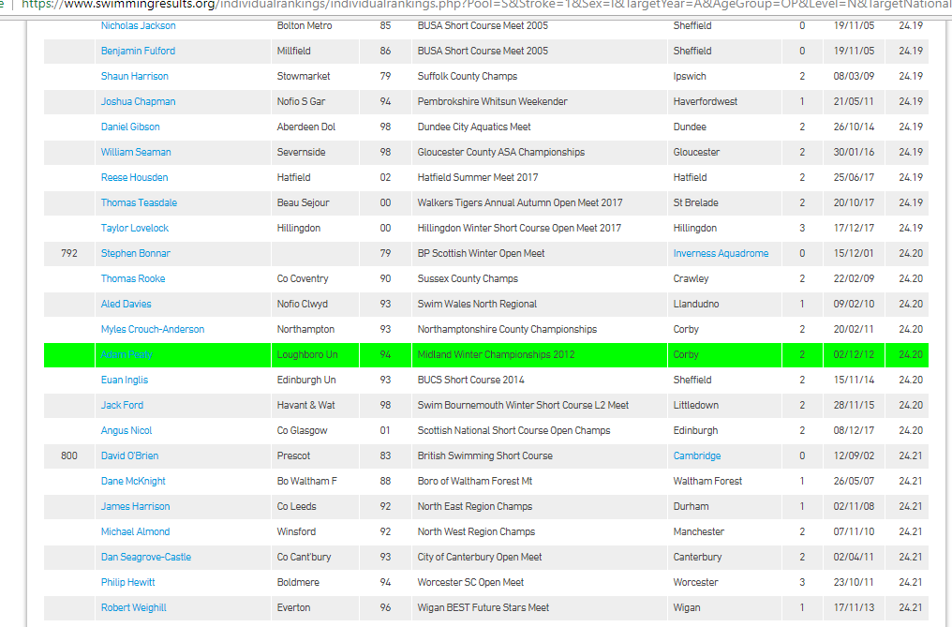
Joint 792 fastest in Britain!

